Slide 1
Medical Professional Liability Insurance Claim Reports
Online Claim Report User’s Guide

Slide 2
System Overview
To better assist our patrons, Medical Professional Liability Insurance Claim reports can now be created, updated, and closed online. This tutorial is designed to guide a user through account creation, account management, and claim management.
Site Address: https://apps.difp.mo.gov/profliab

Slide 3
Account Management
New Users will need to create accounts, that will be approved by staff in Statistical Analysis of DIFP, before claims can be created, updated, or closed. User will not be able to access the system until the registration is accepted.

Slide 4
Account Registration
Users will need to create and/or provide the following information when registering an account with DIFP:
Create a User Name
Provide a valid Email Address
Create a Password
Provide valid NAIC number(s)
Provide Contact Name
Provide Contact Phone Number
Provide Contact Address Information

Slide 5
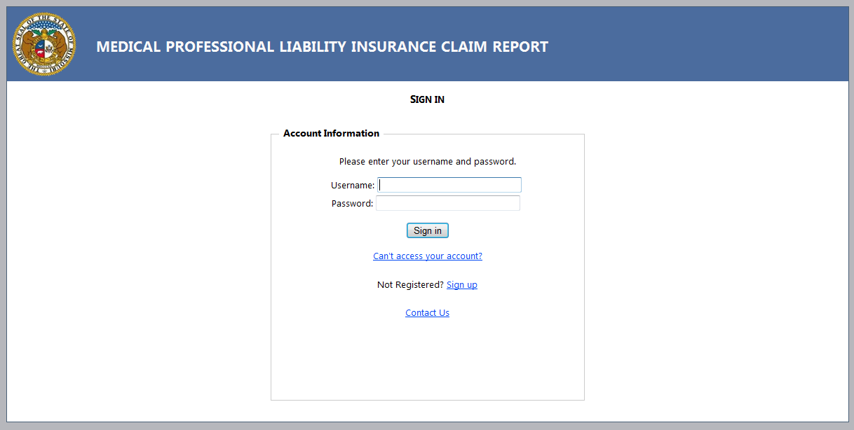
Account Registration
New user’s should register with DIFP to gain access to the application. Simply, select Signup to being the process from the login page.

Slide 6
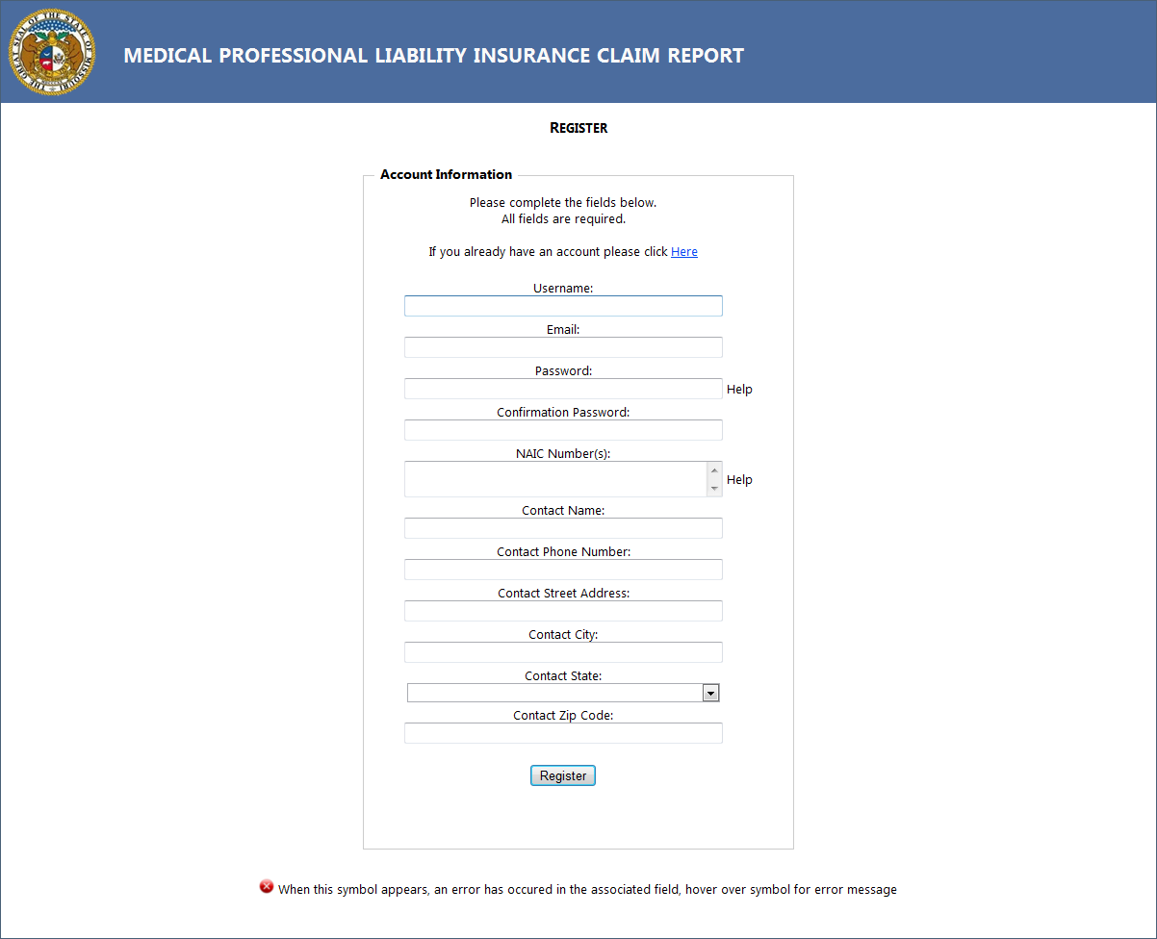
Registration Page
After selecting the signup link. You will be directed to the following page.

Slide 7
Account Registration
Begin the sign up process by providing the requested information. All information requested is required to complete account registration. Follow prompts to correct online registration inconsistencies or errors. Select the “Register” button to submit registration.

Slide 8
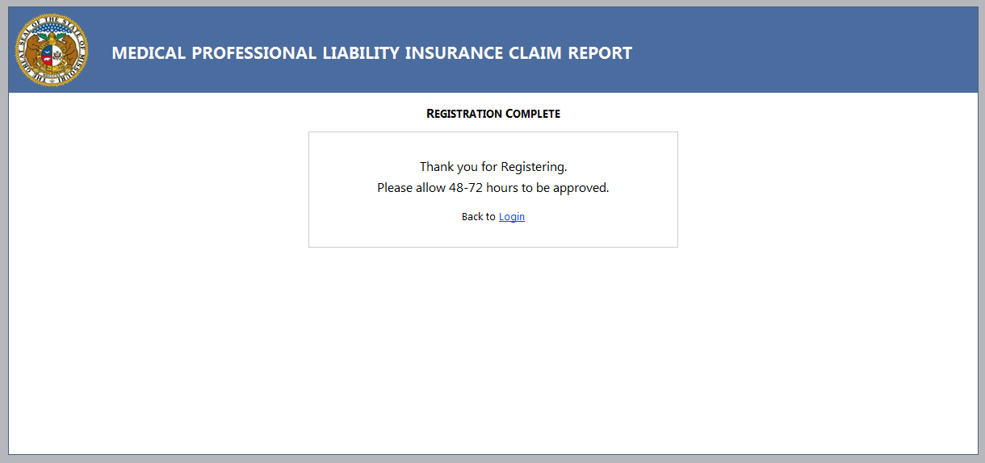
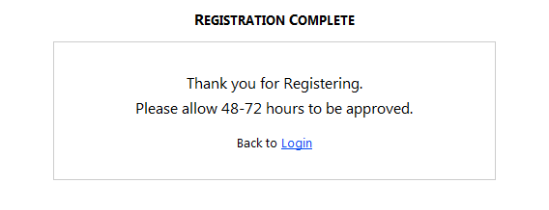
Registration Complete
After selecting the “Register” button you will be directed to the registration complete page. You will also receive an email notification verifying your registration.
It is important to note that processing registrations can take up to 48-72 hours before approval is received. You will receive a confirmation email once your account is accepted.

Slide 9
Contact Information Updates
You will need to login to your account in order to manager your account settings.
You can change your password, email account, and contact information online through the account settings option.
Updates to accounts will be approved immediately but changes to accounts will be processed nightly.

Slide 10
Account Login Screen

Slide 11
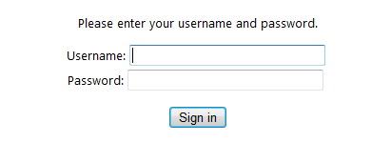
Account Login
To login, you will be asked to provide your username and password.
If you forget your account login information, you may request your information sent to your on file email address by selecting the “Can’t access your account?” link.

Slide 12
Homepage
The homepage will allow you to navigate to your account settings, open, update and modify a claim, and direct you to DIFP contact information.

Slide 13
Account Settings
Settings
Navigate to the Account Settings by selecting the “Account Settings” link at the top right of the Home page.

Slide 14
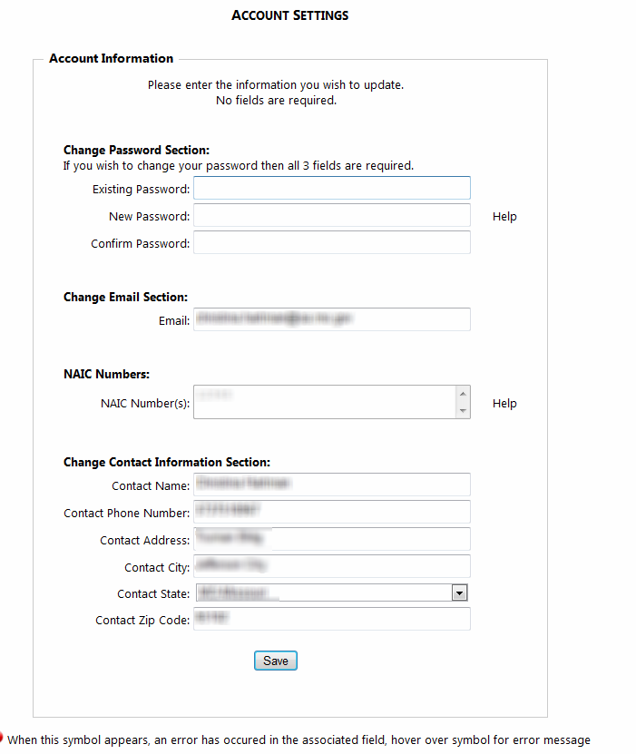
Account Settings
Complete any necessary changes and click “save”.
If you need to make changes to your NAIC number, please contact the office of DIFP.

Slide 15
Account Settings Saved
After you save your changes, you will be directed to the account settings saved page.

Slide 16
Managing Claims
Menu Options
From the homepage you can select one of the following options for claims management:
Open Claim
Opens online form for new claim creation
Update Claim
Used to modify an existing claim
Close Claim
Used to close an existing claim

Slide 17
Create a Claim
Menu Bar
To create a claim, select the “Open Claim” from the menu bar.

Slide 18
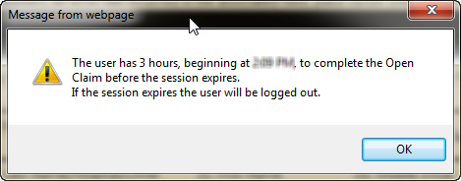
Claim Creation Notification
When you open the form, a prompt will inform you that you only have three hours to complete the form before you are logged out of the system.

Slide 19
Create a New Claim
Form Help
Obtain form instructions by selecting the link titled “Here” at the top of the form.

Slide 20
File Submitted Screen
After you submit your claim, you will be redirected to a new screen that includes your filing number.
Be sure to keep this number, it will be useful in the future when you modify or close your claim.
Claim processing can take 48-72 hours.

Slide 21
Update an Existing Claim
From this screen you can update your claim.
You will need to provide your web filing number or claim file identification and your NAIC Number – which you can select from the drop down menu.
After you’ve entered the required information select the “Update” button.
Do not use the Update tab to close a claim

Slide 22
Close an Existing Claim
From this screen you can close your claim.
You will need to provide your web filing number or claim file identification and your NAIC Number – which you can select from the drop down menu.
After you’ve entered the required information select the “Close” button.

Slide 23
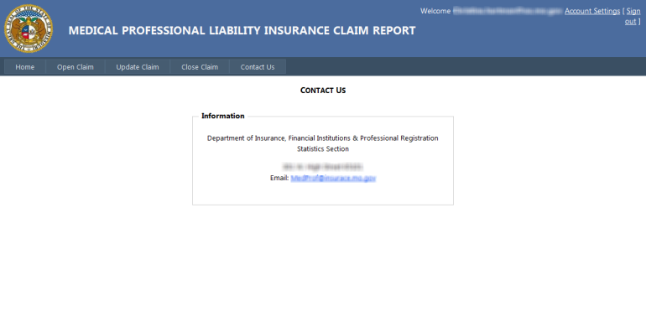
Find Assistance On Our Contact Page or on the Claims Form
Form Instructions
Contact Us Page
Form instructions are provided for entities filing a new claim. (See filing a claim)
Contact information is provided on our Contact Us page in the system.
Medical Professional Liability Link

